Slide 1
Instructor: Dr. Pradeep Buddharaju
CSCI/CINF 4320 – Spring 2022
WEB APPLICATION DEVELOPMENT
Lecture 11 – Introduction to Database Programming and ADO.NET

Slide 2

Lecture Overview
Relational Database
SQLDataSource and Gridview Control
Introduction to ADO.NET

Slide 3
What is a Relational Database?
Relational Database
SQLDataSource and Gridview Control
Introduction to ADO.NET
A Relational database is a collection of tables (also called relations)
A Table
Collection of rows (also called tuples or records)
Each row in a table contains a set of columns (also called fields or attributes)
Each column has a type:
Integer: INTEGER
Floating-point: FLOAT, DOUBLE
Date/time DATE, TIME, DATETIME
Several others...
Primary key: provides a unique identifier for each row
Schema:
The table name
The names and types of its columns
Various optional additional information (constraints, etc.)

Slide 4
SQL
Relational Database
SQLDataSource and Gridview Control
Introduction to ADO.NET
SQL stands of Structured Query Language
a language for creating and manipulating relational databases
Initially created at IBM as part of System-R
Implemented with modifications in numerous products: Oracle, Sybase, DB-2, SQL Server, MySQL etc
Has been (partially) standardized
In this course we will use SQL Server
Most important SQL commands:
CREATE TABLE
INSERT
SELECT
UPDATE
DELETE

Slide 5
CREATE TABLE
Relational Database
SQLDataSource and Gridview Control
Introduction to ADO.NET
This command is used to create a table in database
CREATE TABLE Student(
stuId VARCHAR(6),
lastName VARCHAR(20) NOT NULL,
firstName VARCHAR(20) NOT NULL,
major VARCHAR(10),
credits INT DEFAULT 0,
CONSTRAINT Student_stuId_pk PRIMARY KEY (stuId),
CONSTRAINT Student_credits CHECK ((credits>=0) AND (credits<150)));

Slide 6
INSERT
Relational Database
SQLDataSource and Gridview Control
Introduction to ADO.NET
This command is used to insert rows into a table
INSERT INTO STUDENT VALUES('S1001','Smith','Tom','History',90);
INSERT INTO STUDENT VALUES('S1002','Chin','Ann','Math',36);
INSERT INTO STUDENT VALUES('S1005','Lee','Perry','History',3);
INSERT INTO STUDENT VALUES('S1010','Burns','Edward','Art',63);
INSERT INTO STUDENT VALUES('S1013','McCarthy','Owen','Math',0);
INSERT INTO STUDENT VALUES('S1015','Jones','Mary','Math',42);
INSERT INTO STUDENT VALUES('S1020','Rivera','Jane','CSC',15);

Slide 7
SELECT
Relational Database
SQLDataSource and Gridview Control
Introduction to ADO.NET
This command (also known as query) is used to read (or select) rows from table(s)
Show all the data in the Student table:
SELECT * FROM Student;
Find Id, name and credits of all math majors:
SELECT lastName, firstName, StuId, credits
FROM Student
WHERE major = 'Math';
Find student names and ids order by ids
SELECT lastName, firstName, StuId
FROM Student
ORDER BY StuId;

Slide 8
UPDATE
Relational Database
SQLDataSource and Gridview Control
Introduction to ADO.NET
This command is used to update rows into a table
Change S1020's major to music
UPDATE Student
SET major = 'Music'
WHERE stuId = 'S1020';
Increment all students' credits by 3
UPDATE Student
SET credits = credits + 3;

Slide 9
DELETE
Relational Database
SQLDataSource and Gridview Control
Introduction to ADO.NET
This command is used to delete rows from a table
Drop S1020's student record
DELETE
FROM Student
WHERE StuId = 'S1020';

Slide 10
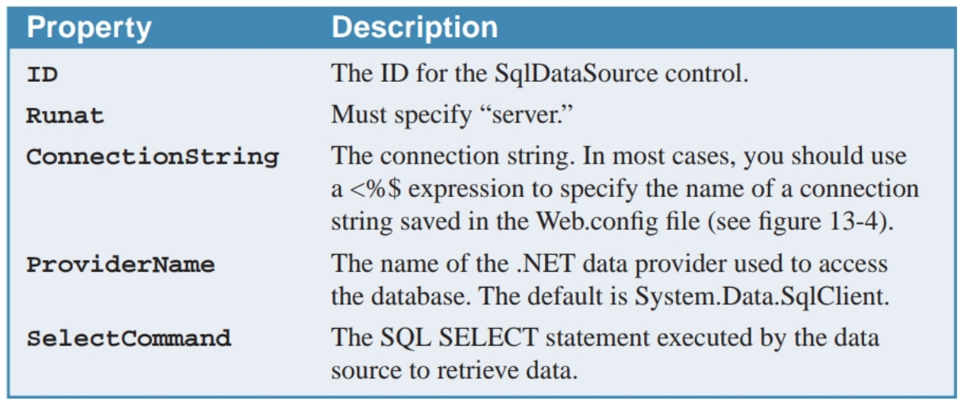
SQLDataSource Control
Relational Database
SQLDataSource and Gridview Control
Introduction to ADO.NET
A SqlDataSource control (or SQL data source) provides the information an application needs to connect to a database and retrieve, insert, update, and delete data needed by the application
Important properties:

Slide 11
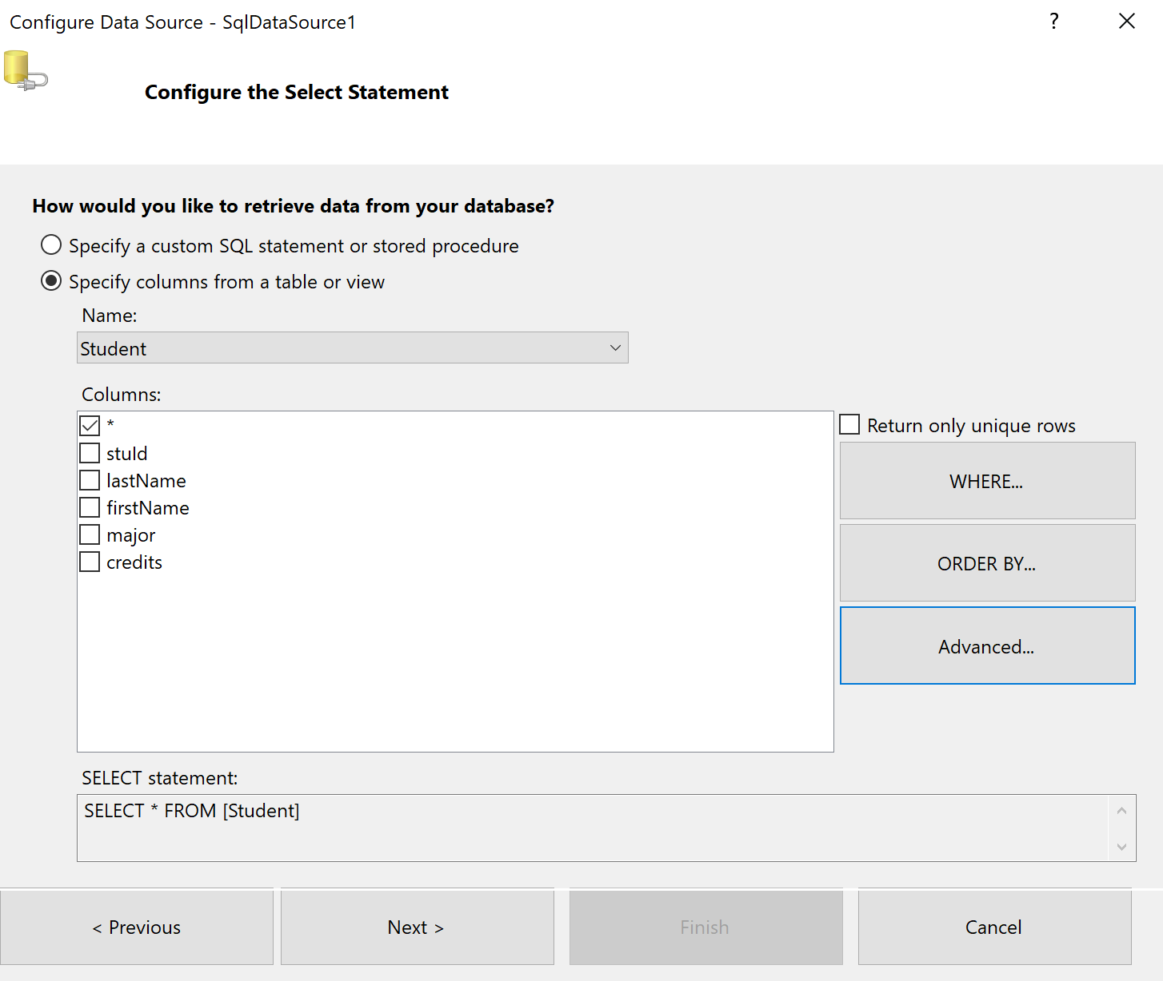
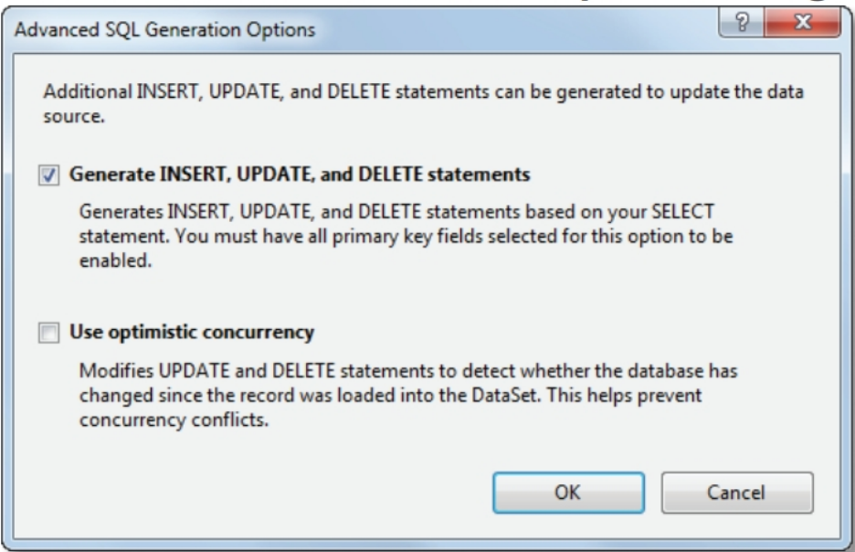
Update and Delete in DataSource
Relational Database
SQLDataSource and Gridview Control
Introduction to ADO.NET
To automatically generate INSERT, UPDATE, and DELETE statements for a data source, check the first box in the dialog box that you get by clicking on the Advanced button in the Configure DataSource window

Slide 12
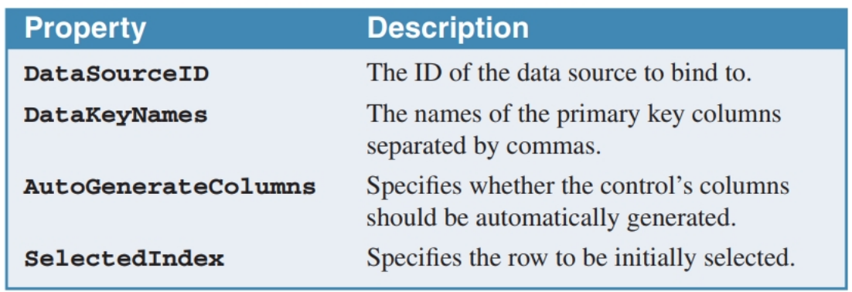
GridView Control
Relational Database
SQLDataSource and Gridview Control
Introduction to ADO.NET
The GridView control displays data from a data source in a row and column format. The data is rendered as an HTML table.
To create a GridView control, drag the GridView icon from the Data group of the Toolbox.
To bind a GridView control to a data source, use the smart tag menu’s Choose Data Source command.
Basic properties of the GridView control:

Slide 13
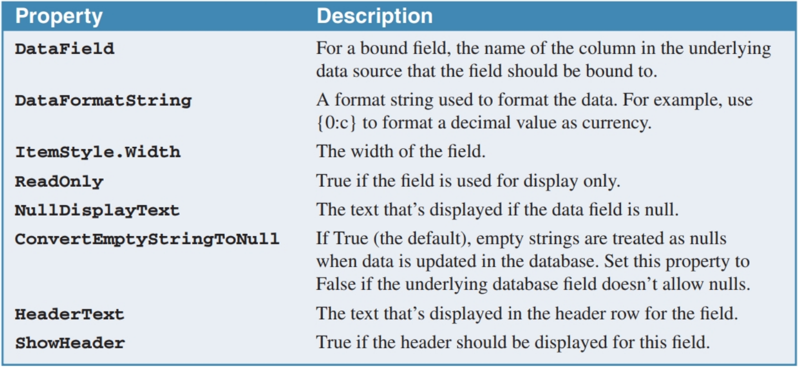
Customizing GridView Columns
Relational Database
SQLDataSource and Gridview Control
Introduction to ADO.NET
By default, the GridView control displays one column for each column in the data source
To define the fields that you want to display in the GridView control, display the Fields dialog box by selecting the Edit Columns command from the control’s smart tag menu
Commonly used field properties:

Slide 14
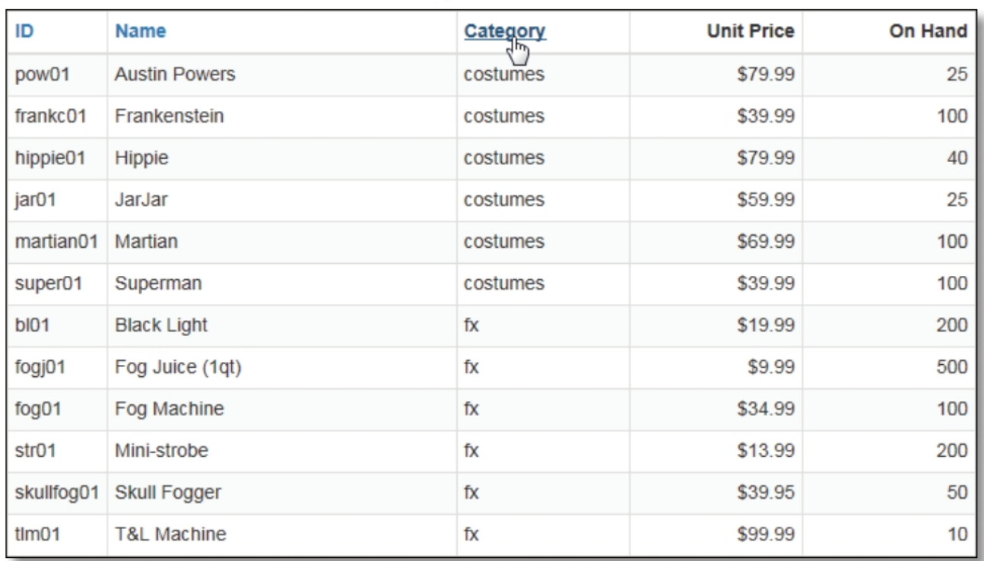
Sorting
Relational Database
SQLDataSource and Gridview Control
Introduction to ADO.NET
To enable sorting, set the AllowSorting property to True.
Then, add a SortExpression property to each column you want to allow sorting for.
For sorting to work, the DataSourceMode property of the data source must be set to DataSet mode, which it is by default.

Slide 15
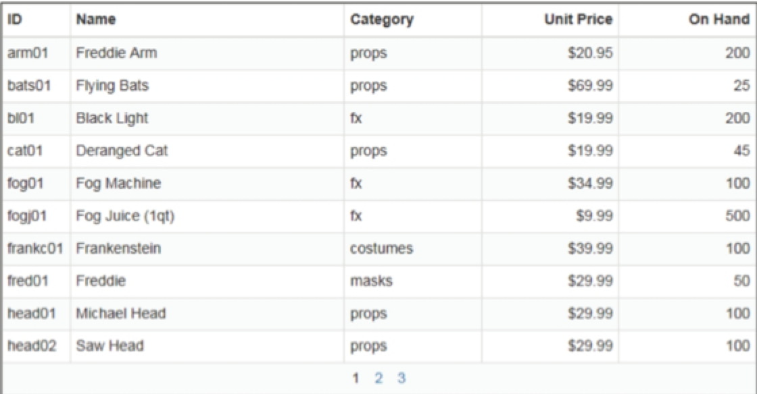
Paging
Relational Database
SQLDataSource and Gridview Control
Introduction to ADO.NET
Paging refers to the ability of the GridView control to display bound data one page at a time, along with paging controls that let the user select which page of data to display next
To enable paging, set the AllowPaging property to True
Then, add a PagerStyle element to define the appearance of the pager controls
For paging to work, the DataSourceMode property of the data source must be set to DataSet mode, which it is by default

Slide 16
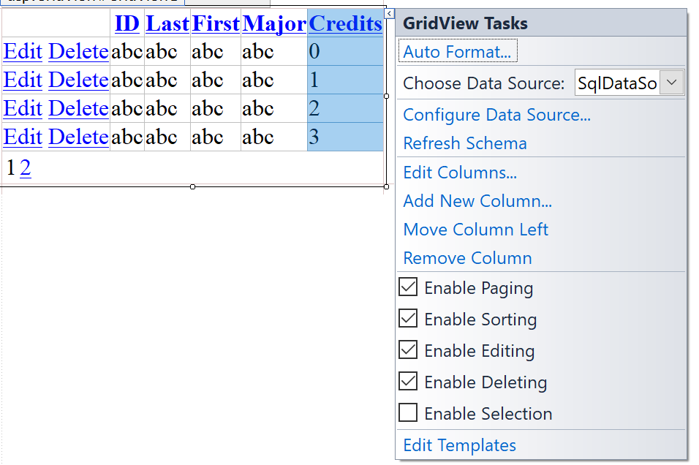
Enabling Editing and Deleting in GridView
Relational Database
SQLDataSource and Gridview Control
Introduction to ADO.NET
You can enable Editing and Deleting by checking the corresponding options from the control’s smart tag menu

Slide 17
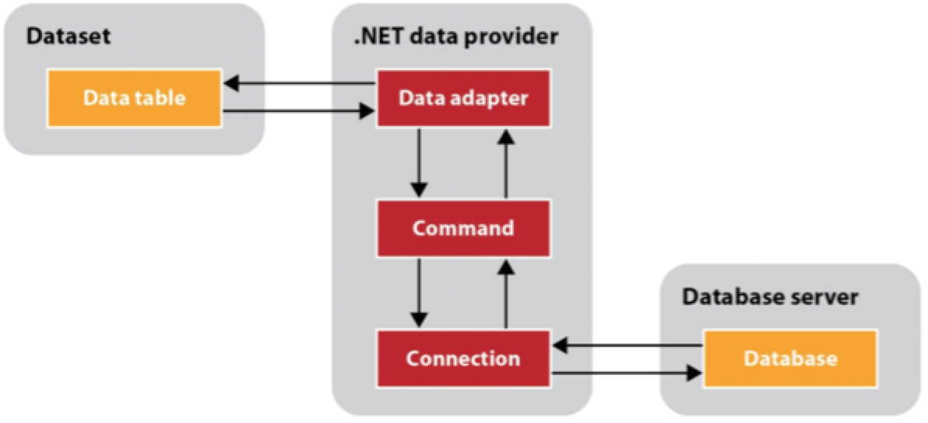
What is ADO.NET?
Relational Database
SQLDataSource and Gridview Control
Introduction to ADO.NET
ADO.NET
ADO.NET (ActiveX Data Objects) is the primary data access API for the .NET Framework
Provides the classes that are used when you develop database applications
Uses two types of objects to access the data in a database:
Datasets: stores data from the database so it can be accessed by the application
Data provider: objects, which include data adapters, commands, connections

Slide 18
Create Business Layer Class
Relational Database
SQLDataSource and Gridview Control
Introduction to ADO.NET
Create a new business layer class to include the logic of database operations
Add the following ADO.NET imports:
using System.Data;
using System.Data.SqlClient;
using System.Configuration;
Add the following member variable to hold database connection:
SqlConnection connection = new SqlConnection(ConfigurationManager.ConnectionStrings["YOUR CONNECTION STRING"].ConnectionString);

Slide 19
SELECT using ADO.NET
Relational Database
SQLDataSource and Gridview Control
Introduction to ADO.NET
public string getFullName(string studentID)
{
// define SQL SELECT query with parameters
string selectSQLCommand = ”SELECT firstName,lastName FROM Student WHERE stuId = @stuId";
try
{
// create a command object
SqlCommand command = new SqlCommand(selectSQLCommand, connection);
command.Parameters.Add("@stuId", SqlDbType.VarChar).Value = studentID;
// open connection, execute SELECT, close connection
connection.Open();
SqlDataReader reader = command.ExecuteReader();
string fullName = null;
while (reader.Read())
{
string firstName = reader.GetValue(0).ToString();
string lastName = reader.GetValue(1).ToString();
fullName = firstName + " " + lastName;
}
reader.Close();
command.Dispose();
connection.Close();
return fullName;
}
catch
{
return null;
}
}

